Slide 1
Training for preceptors
Jamie weber, ms, rdn, cd

Slide 2
AGENDA
CEUs for precepting
Introduction of faculty
overview of programs
expectations of a precepting site
tips for working with interns
best communication when precepting
oral vs written feedback
navigating Sonia
Evaluation standards
resources

Slide 3
THANK YOU to EACH & EVERY ONE OF YOU!

Slide 4
DO I EARN CEUS FOR PRECEPTING?
You can earn 3 CEU’s per semester.
You will receive a signed CEU document from Viterbo within 4-weeks of the supervised-practice experience completion.
A maximum of 3 CPEUs per year or a total of 15 CPEUs per 5-year cycle.
https://www.cdrnet.org/cpeu-credit-for-preceptors

Slide 5
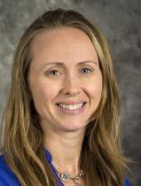
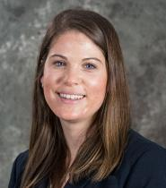
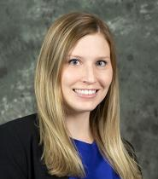
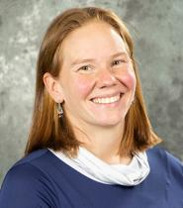
Nutrition & dietetics faculty
Jamie Weber, MS, RDN, CD
Viterbo University
Assistant Professor
Coordinated Program Director
Nutrition & Dietetics Department
jaweber@Viterbo.edu
Dr. Maria Morgan-Bathke, MBA, PhD, RDN
Viterbo University
Associate Professor
Dietetic Internship Program Director
Department Chair
Nutrition & Dietetics Department
memorganbathke@Viterbo.edu
Dr. Kelsey McLimans, PhD, RDN
Viterbo University
Assistant Professor
Graduate Program Director
Nutrition & Dietetics Department
kemclimans@Viterbo.edu
Tiffany Lein, MPH, RDN
Viterbo University
Assistant Professor
Nutrition & Dietetics Department
tllein@Viterbo.edu

Slide 6
Overview of programs

Slide 7
 | Track 1: Dietetic Internship Only | Track 2: Dietetic Internship + Non-Thesis Masters (clinical focus) | Track 3: Dietetic Internship + Thesis Masters | 4+1 Program | DE Program
Description | These students have graduated with a bachelor’s in nutrition & dietetics from an accredited program. They already have a master’s degree, but need supervised practice (SP) hours. They can complete SP hours in La Crosse, WI or anywhere within the US or its territories. | These students have graduated with a bachelor’s in nutrition & dietetics from an accredited program. They will complete both a master’s degree and supervised practice (SP) hours. They can complete SP hours in La Crosse, WI or anywhere within the US or its territories. | These students have graduated with a bachelor’s in nutrition & dietetics from an accredited program. They will complete both a master’s degree and supervised practice (SP) hours. SP hours MUST be outside of La Crosse, WI but can be anywhere within the US and its territories. | This program is for students who start at Viterbo their first year, or transfer. They will complete a bachelor’s, master’s and SP hours in 5 years (including 1 summer). SP for NUTR481 (Foodservice) will take place in La Crosse, but NUTR670 (Community) and NUTR671(MNT) can be completed in La Crosse, WI or anywhere within the US and its territories. | This program is for students who have a bachelor’s degree in something other than nutrition & dietetics, but want to be a RDN. MUST complete science prerequisites and receive a minimum grade of a “C” to apply for program. They will take select nutrition course remotely and complete SP for NUTR681 (Foodservice), NUTR670 (Community), and NUTR671(MNT) can be completed in La Crosse, WI, but will likely be completed outside of La Crosse, anywhere within the US and its territories.
Clinical Hours | 1400 | 1400 | 1024 | 1152 | 1152
Total Credits | 30 CREDITS TOTAL | 48 CREDITS TOTAL | 39 CREDITS TOTAL | 158 CREDITS TOTAL (121 UG credits; 28 GR credits + 9 graduate credits at the UG level) | 62 CREDITS TOTAL

Slide 8
expectations of a precepting site

Slide 9
Preceptor’s guide
https://www.viterbo.edu/sites/default/files/2022-02/Preceptors_Guide_2022_0.pdf

Slide 10
Tips for working with interns

Slide 11
Provide a clear orientation prior to reporting to site
Have student review modules
Reading materials
What is the dress code? Do they need a lab coat?
Should they pack their lunch? Is there a cafeteria?
Provide an outline of the 1st day & typical day
Parking; Do they need a parking pass?
Where & when should the student/intern report?
If a larger facility, a map may be helpful.

Slide 12
FIRST DAY ONSITE FOR STUDENT/INTERN
Establish ground rules/define expectations (student & preceptor)
Tour of the facility (in-person or recorded)
Meet additional staff members, as appropriate
Explain the work norms & describe a daily schedule
Check-in process with students- daily, weekly?

Slide 13
Additional Teaching Hints
While onsite
Recommend morning/end of the day meeting
Continuously evaluate & provide feedback (daily, weekly)
Clearly defined due dates
While working remotely
Set scheduled meeting via Zoom (Every morning, 2x/week minimally)
Clear expectations (put in writing)
Clearly defined due dates

Slide 14
A Teaching Model for Preceptors:
A useful teaching model for preceptors to use is Pichert’s DR FIRM model. It is a framework that identifies how the preceptor and student can effectively interact in the skills for the teaching/learning process. DR FIRM is an acronym for:
D: Demonstration, presentations and problem-solving
R: Rehearsal of content
F: Feedback and correction
I: Independent practice
R: Review
M: Motivate to persevere

Slide 15
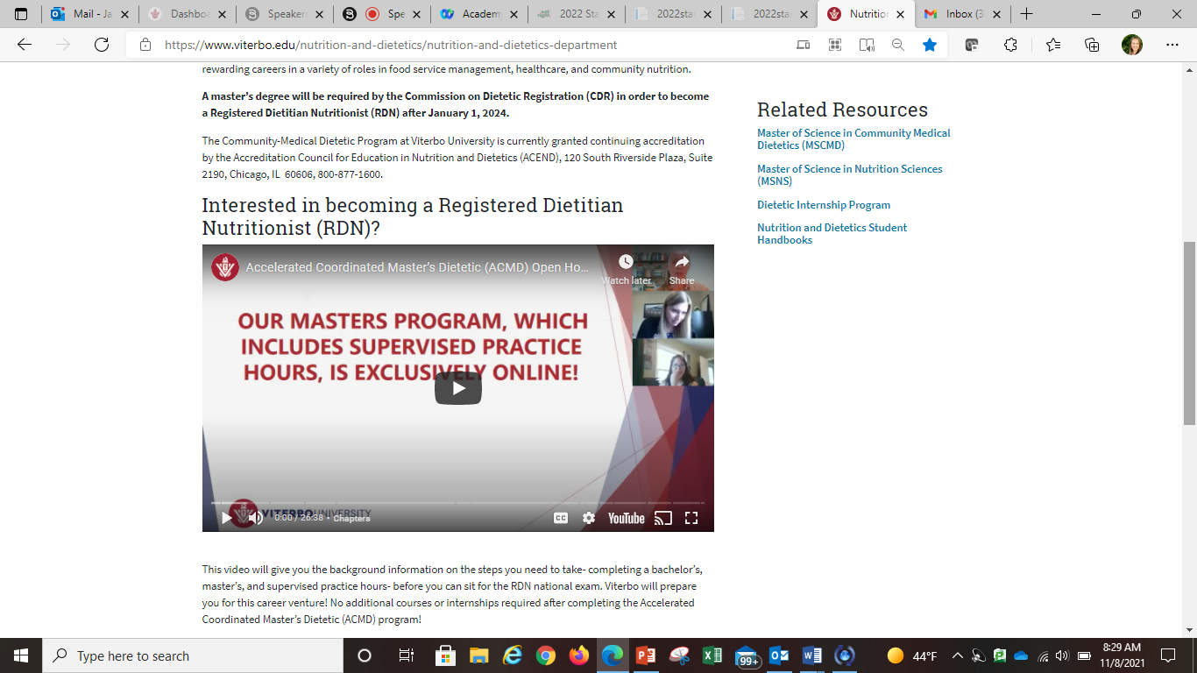

Slide 16
best communication when precepting

Slide 17
Who should I contact?
Issues with Sonia- password reset, evaluation are not linked, continue receiving evaluation reminders Contact Jamie Weber
Student concerns-professionalism, nutrition knowledge, etc. Contact Course Instructor

Slide 18
oral vs written feedback

Slide 19
Type of feedback?
ORAL FEEDBACK (generally speaking)
• Counseling (inpatient/outpatient)
WRITTEN FEEDBACK (generally speaking)
• Newsletter, blog, presentation (developing or evaluating)
Meet the student where they are at.

Slide 20
navigating Sonia

Slide 21
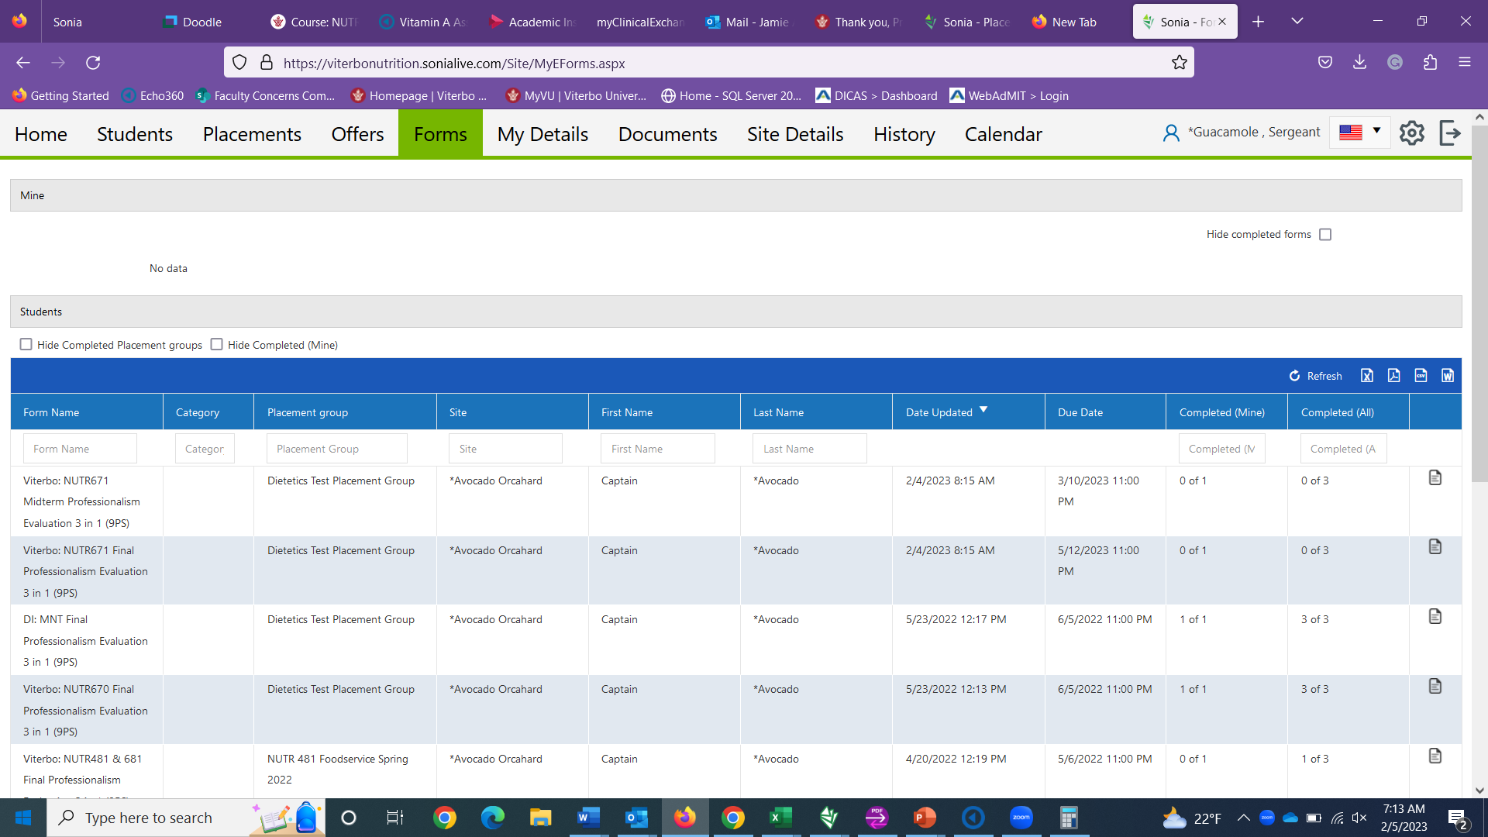

Slide 22
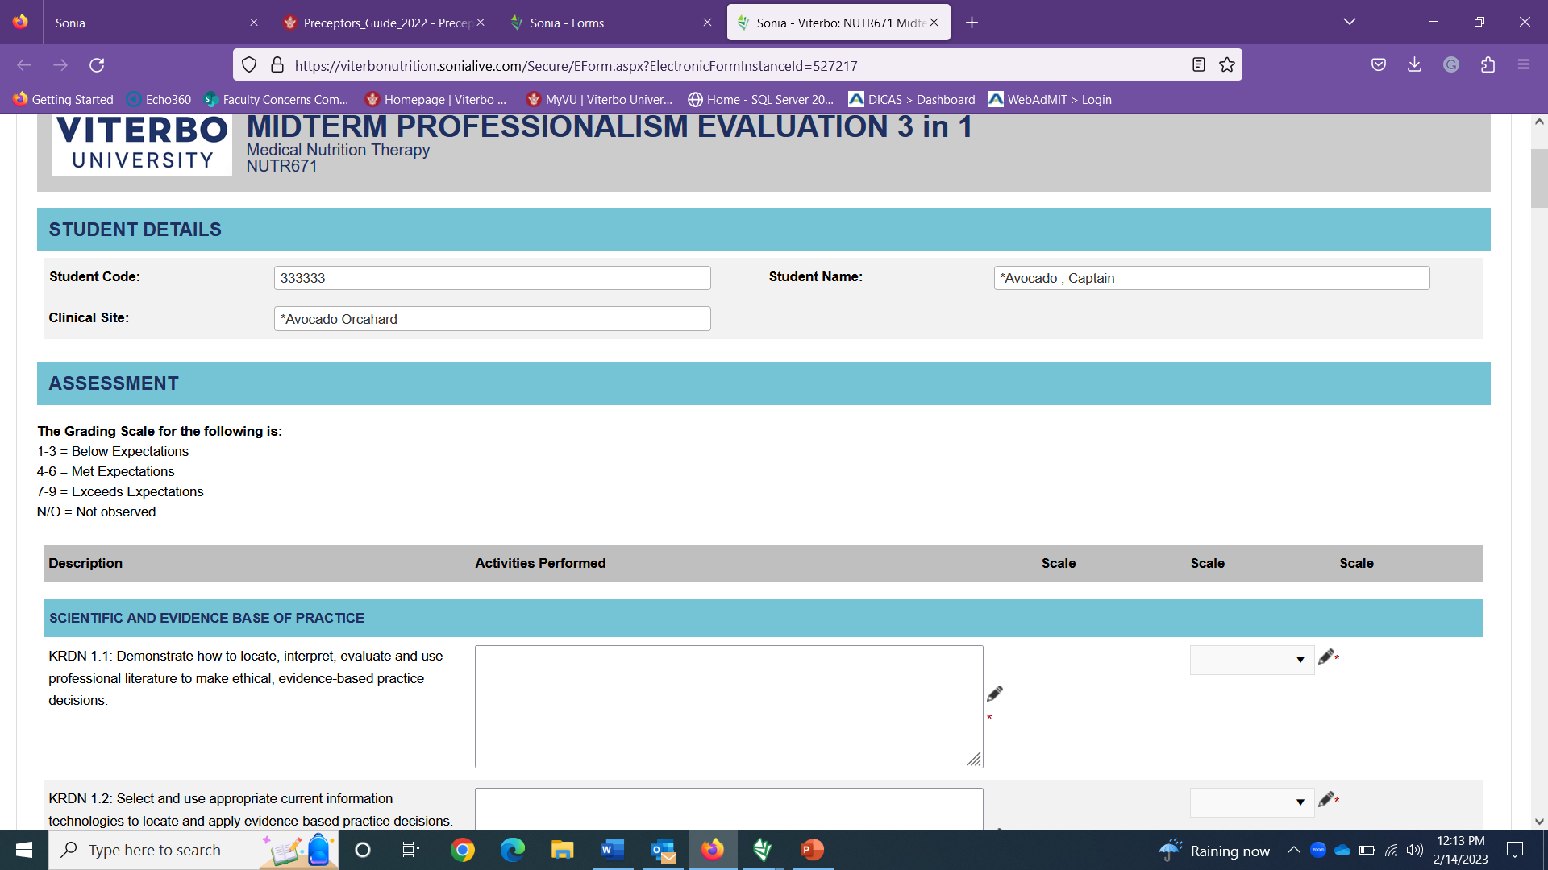
Sonia demo

Slide 23
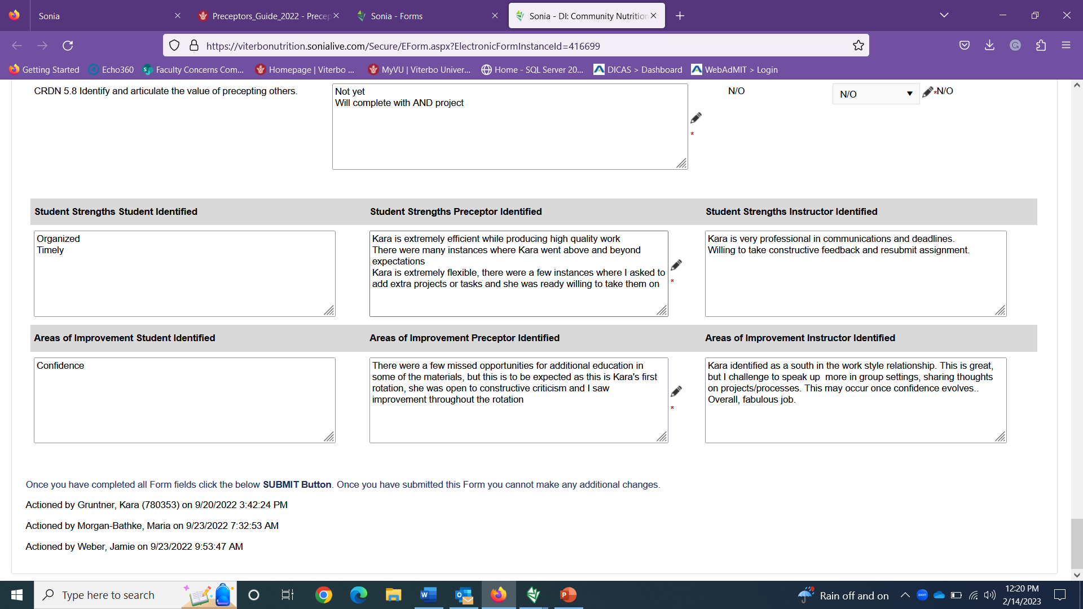

Slide 24
Evaluation standards

Slide 25
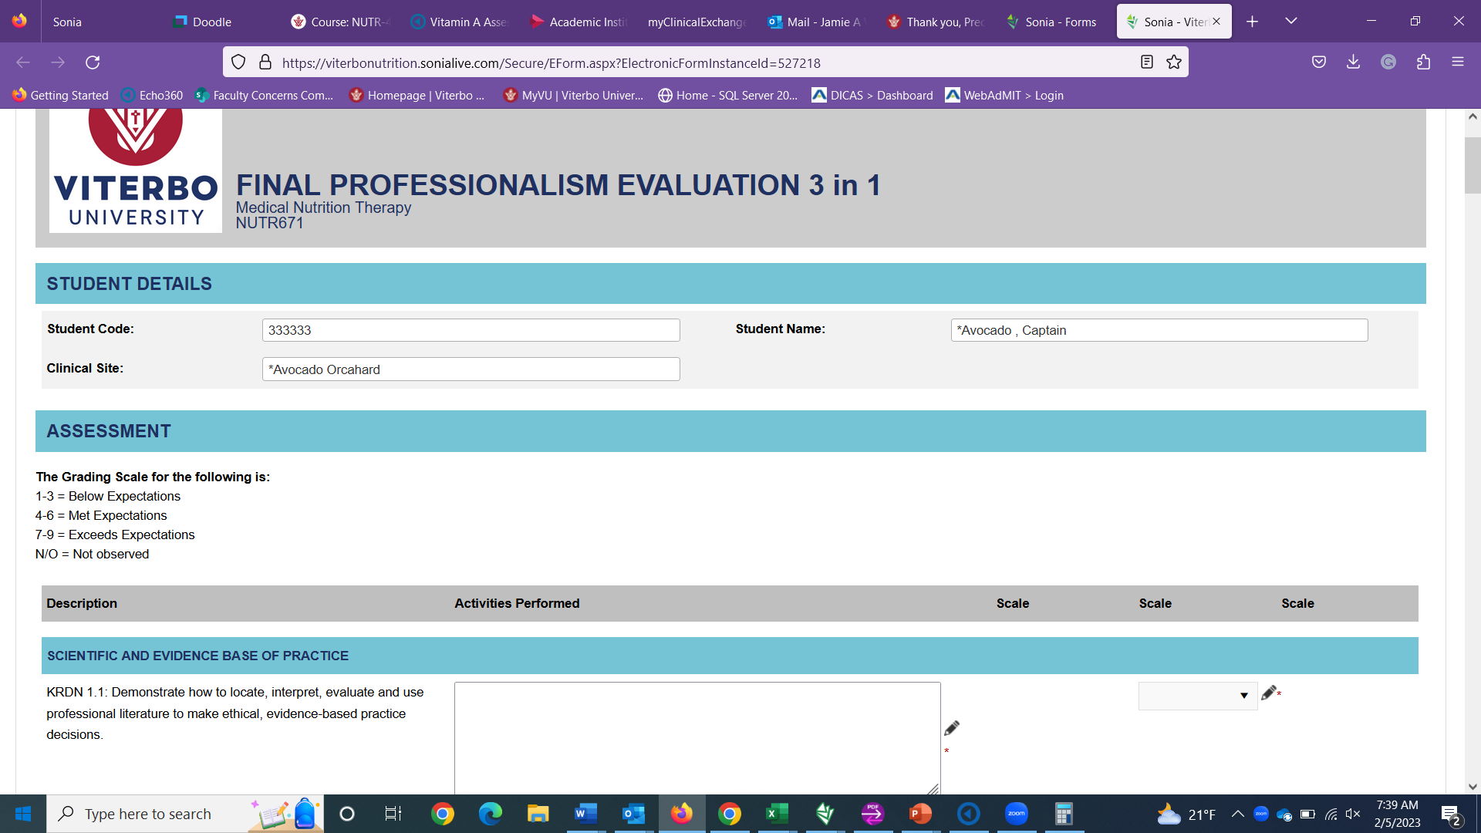

Slide 26
What if we can’t meet CRDNs?
Communicate this with the course instructor by the end of Week 1 of the rotation!

Slide 27
resources

Slide 28
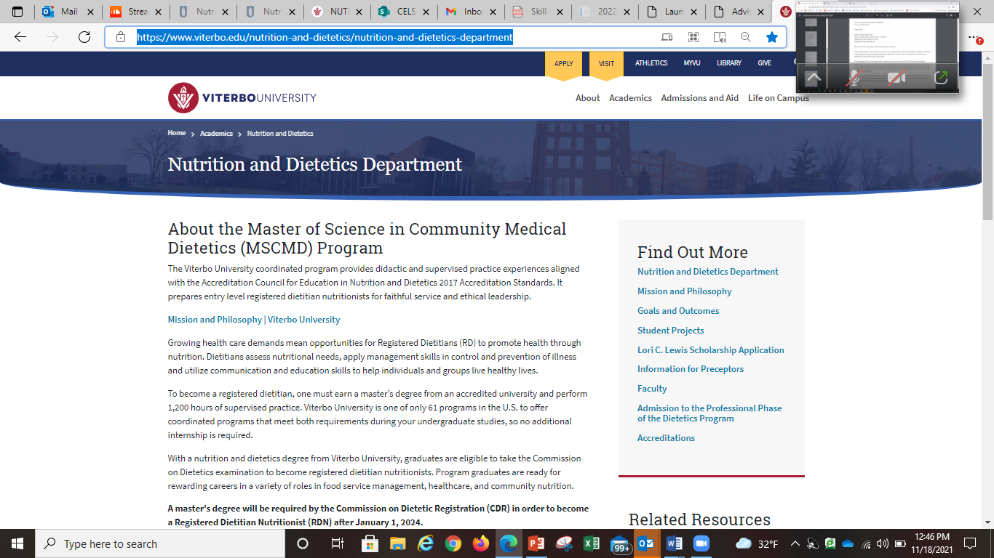
AREAS OF FOCUS

Slide 29
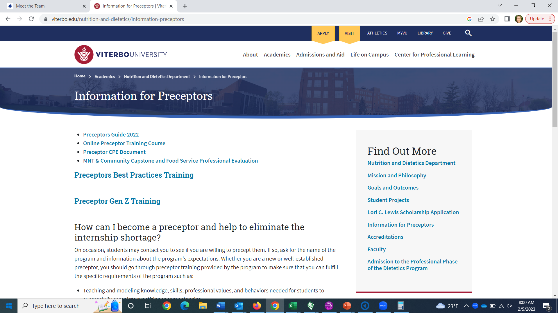
AREAS OF FOCUS

Slide 30
Questions?
Jamie Weber
jaweber@viterbo.edu

Slide 31
“The delicate balance of mentoring someone is not creating them in your own image but giving them the opportunity to create themselves.” — Steven Spielberg
“In learning you will teach, and in teaching you will learn.”
– Phil Collins
"A mentor is someone who sees more talent and ability within you, than you see in yourself, and helps bring it out of you." — Bob Proctor

Slide 32
THANK YOU

