Slide 1
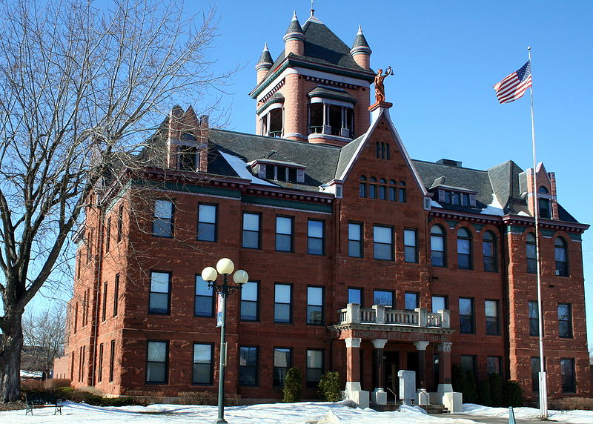
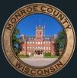

Virtual
Town Hall
FREE AND OPEN TO THE PUBLIC
Monroe County
Problem-Solving Courts: Stories and Statistics
June 21st
1:30-2:30 p.m.
Hosted by the Viterbo University VOICE Initiative and Monroe County
To register:
https://www.viterbo.edu/voice/voice-town-hall
This program is supported by the Health Resources and Services Administration (HRSA) of the U.S. Department of Health and Human Services (HHS) as part of an award totaling $741,201.00 with 0% financed with non-governmental sources. This information or content and conclusions are those of the author(s) and do not necessarily represent the official views of, nor an endorsement, by HRSA, HHS or the U.S. Government.

Slide 2
Schedule
Introductions
Overview of Viterbo VOICE Initiative
Monroe County Problem-Solving Courts
What are we asking
Q & A
A justice perspective on court system

Slide 3
Viterbo University VOICE Initiative
Recruit and Support - Recruit 45 Counselor Education students into the VOICE initiative and support them in Practicum-Internships.
Enhance - learning and provide educational and networking events regarding OUD, SUD and/or children, adolescent, and youth in integrated behavioral health settings.
Develop and Expand - Develop and expand internship sites in integrated care settings that serve clients with OUD and SUD and/or at-risk youth in high need and high demand areas.

Slide 4
Monroe County Drug Court
Honorable Rick Radcliffe - Monroe County Circuit Court Branch III
Tara Nichols - Monroe County Justice Program’s Assistant Coordinator – Treatment Court Coordinator
Robyn McAlpine - Monroe County Drug Court Case Manager – VOICE Grant recipient

Slide 5
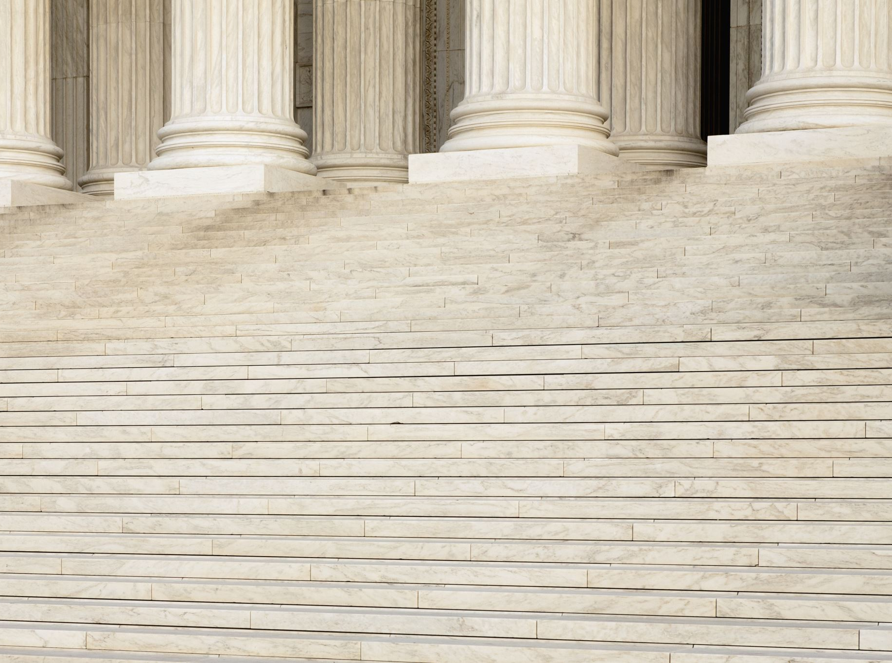
Introduction to the courts
Three problem-solving courts
Drug Treatment Court
OWI Treatment Court
Family Reunification Court

Slide 6
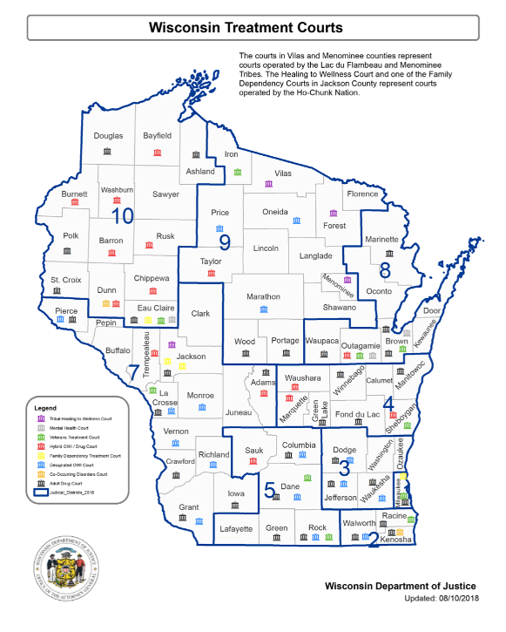

Slide 7
What is a Drug Treatment Court?
•A Drug Treatment Court is a specialized Court that is an effective tool in treating addiction and changing criminal behavior
•Team members include: Multi-disciplinary approach

Slide 8
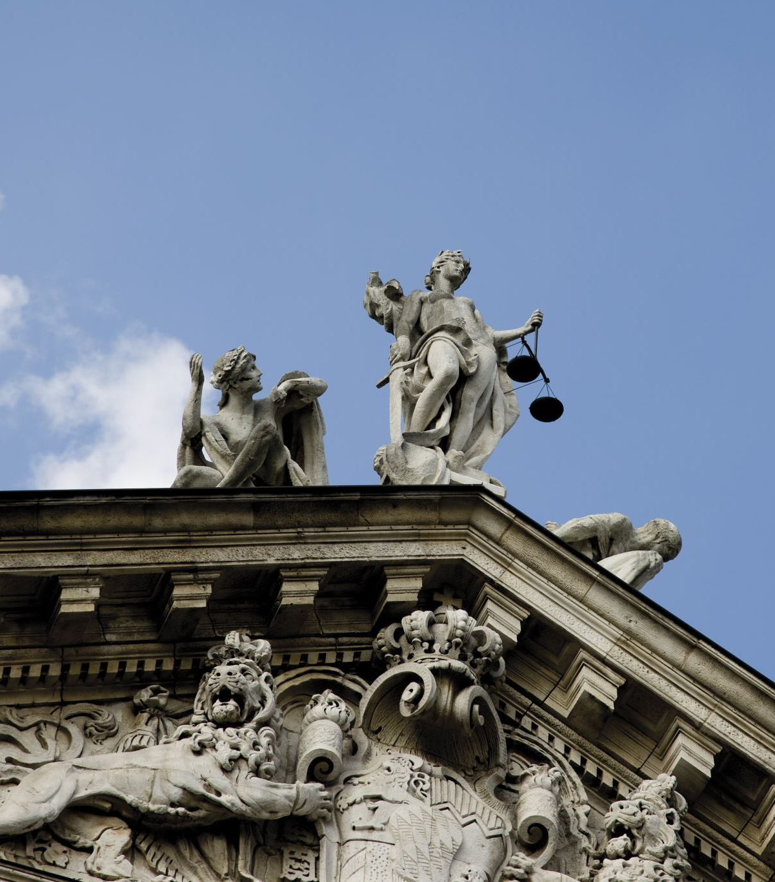
A justice perspective
•Why do we need a Drug Treatment Court in Monroe County?
•What is the state of drug-related offenses in Monroe County?
•What are the impacts of drug use on our families and communities?

Slide 9

Why have a Drug Treatment Court?
•20.2 Million Americans (1 in 10) have a substance abuse disorder
•43.6 Million Americans (1 in 5) have a mental health problem
•8 Million Americans suffer from both disorders
•65% of all inmates have a substance abuse disorder
•90% of all property theft crimes are drug-related
This Photo by Unknown author is licensed under CC BY-NC-ND.

Slide 10
Treatment Courts are successful (Judge Radcliffe)
•Single Most Successful Intervention in Criminal Justice System
•Saves lives, improves education, housing, employment and financial stability
•Promotes family and limits foster care needs
•About 50%-75% of participants graduate program, which is more than double success rates for probation and general inmate population

Slide 11
Treatment Courts Save Money
•For every $1.00 invested, Treatment Courts return on average 4 to 12 times that investment
•Reduced crime and recidivism
•Reduced incarceration
•Reduced costs to system
•Reduced need for services

Slide 12
Recovery: Treatment and Sobriety
•Every 4 minutes someone is sent to treatment instead of prison through treatment courts
•Treatment Court Participants are 37% less likely to test positive for illicit substances
•Treatment Court Participants who graduate with at least 90 days of sobriety have a 164% greater reduction in recidivism

Slide 13
Monroe County Statistics
DA’s office reports a 400% increase in the number of drug charges from 2011 to 2018 – 41% of new cases are repeat offenders
In 2020 51% of charged drug possession cases were referred to the Monroe County Drug Court.
50% of Department of Corrections ATR’s were referred to Drug Court
40 referrals received since inception, 52% accepted into program
Currently 13 active participants

Slide 14
Mission Statement
By providing intensive monitoring, individualized treatment, and comprehensive services to substance dependent offenders, the Monroe County Drug Court will enhance public health and safety, reduce recidivism, and enable participants to break the cycle of addiction.

Slide 15
Team Members
Judge Rick Radcliffe
Coordinator Tara Nichols
Case Manager Robyn McAlpine
Sheriff Dept. Lt. Ryan Hallman
Probation Agent Michelle Jaeger
Public Defender Russ Hammer
District Attorney Kevin Croninger
Treatment Professional Barb Barghahn
Dept of Human Services Emily Nolte

Slide 16

The Community
•Drug Court Team will solicit guidance from community members and Advisory Panel
•Success depends on cooperation along all levels of criminal justice system, including law enforcement, social workers, clerk of courts, prosecutors, defense counsel, probation, treatment providers, community leaders and local business

Slide 17
Program Components
Eligibility Criteria & Referral Process
Phases/Program Structure
Status Hearings
Incentives & Sanctions
Community Supervision

Slide 18

Overview: Role of Treatment
Continuum of care
Team Representation
Evidence-Based Practices
  Treatment Modalities
  Provider Training and Credentials
  Client Autonomy
  Dosage and Duration
  Case Management
  Barriers

Slide 19
Program completion is key
Long-term reduction in recidivism
  An evaluation of the Multnomah County (Portland, Oregon) Drug Court found that crime was reduced by 30% over 5 years, and effects on crime were still detectable an astounding 14 years from arrest.
•Improved quality of life
  Reduction in mental health symptoms, substance use reductions, greater participation in prosocial activities (school, employment, community service, family relationships)

Slide 20
Successes
In 2014, at least 25,049 participants graduated from US treatment Courts.
The average graduation rate is 59%(50% to 70% range).

Slide 21
Treatment Court Saves Lives
Drug Court story
“My proudest accomplishment so far is being sober for 7 months and not
having cps involved with my newborn son.”
OWI Court story
  “If not for treatment court and it’s staff I’d be dead or drunk right NOW.”
  “You folks took a chance on an out of control drunk and I am forever grateful.”

Slide 22
Questions?
Any future questions can be directed to:
Tara Nichols, Monroe County Justice Programs Assistant Coordinator
tara.nichols@co.monroe.wi.us
Phone: (608) 269-8821
Fax: (608) 269-8894

Slide 23
The “ask” (Judge Radcliffe)
      Increasing support and understanding
        Direct - Donating time, peer support/recovery coach services, organizational support-community service-hiring-vouchers
        Indirect – See the person rather than the addiction

